Slide 1
House price rprediction
Muhammad Muzammil
Danish jamal
Muhammad Mustafa

Slide 2
INtroduction
Our method brings the latest research on prediction markets to further their utilization by economic forecasters. Thus, there is a need to predict the efficient house pricing for real estate customers with respect to their budgets and priorities.
Our system efficiently analyses previous market trends and price ranges, to predict future prices. This topic brings together the latest research on prediction markets to further their utilization by economic forecasters.
It provides a description of prediction markets, and also the current markets which are useful in understanding the market which helps in making useful predictions.
Thus, there is a need to predict the efficient house pricing for real estate customers with respect to their budgets and priorities.

Slide 3
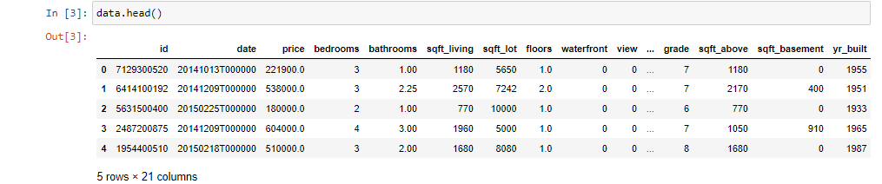
Data set
The dataset was taken from Kaggle. It had more than 20000 values and it had 21 attributes.
The data set explained everything one needs to know when buying a house.

Slide 4
Proposed system
The objective of this project is to predict the house prices so as to minimize the problems faced by the customer.
Data mining algorithms can be used to help investors to invest in an appropriate estate according to their mentioned requirements. Also the new system will be cost and time efficient. This will have simple operations. The proposed system works on Linear Regression Algorithm.
Our system uses linear regression algorithm to predict prices by analyzing current house prices, thereby forecasting the future prices according to the user’s requirements.

Slide 5
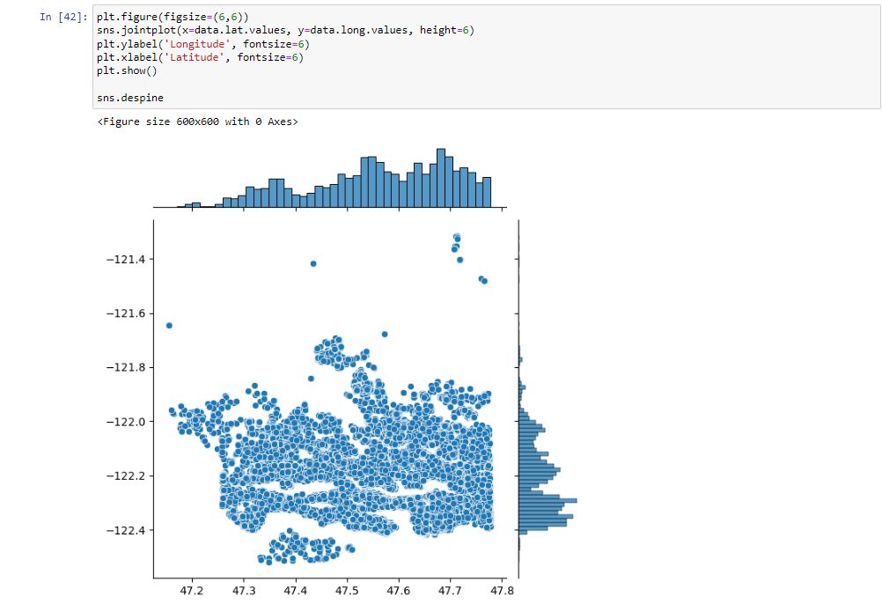
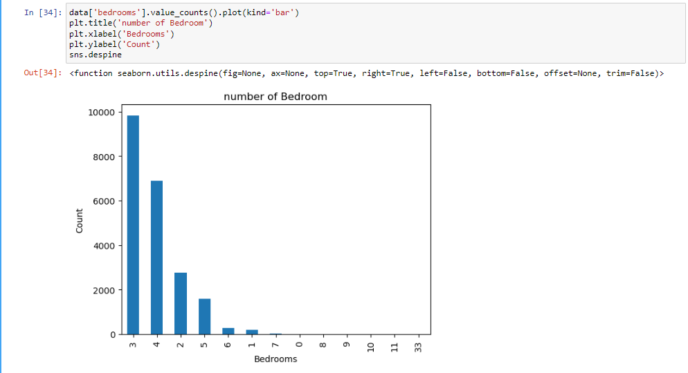
Most common house and featured location
The scatter plots show how many bedrooms are common in a house an what location is suitable.

Slide 6
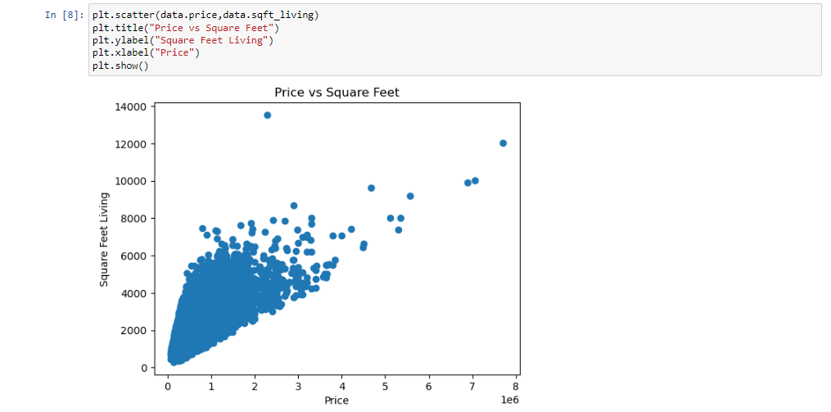
Common attributes and their variation with price
This graph shows the variation of price with the area of the house in square feet.

Slide 7
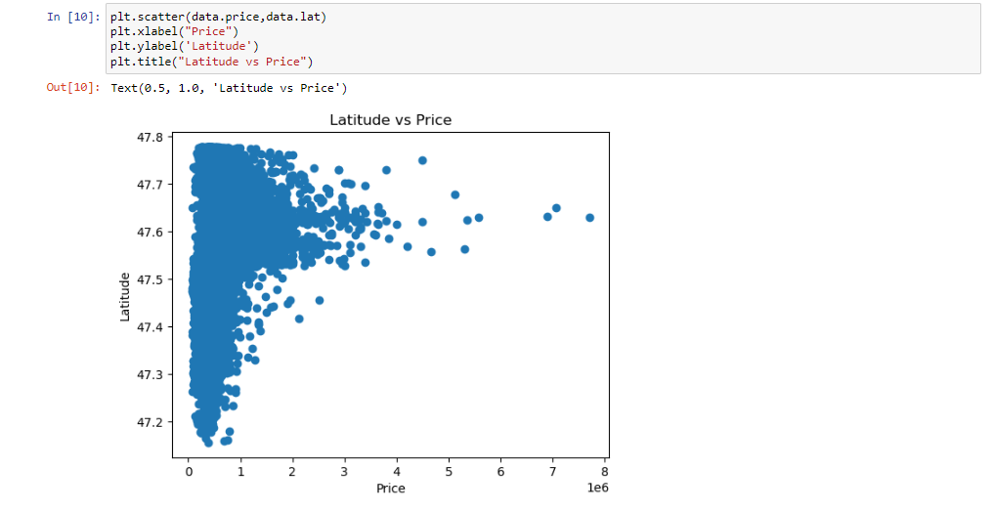
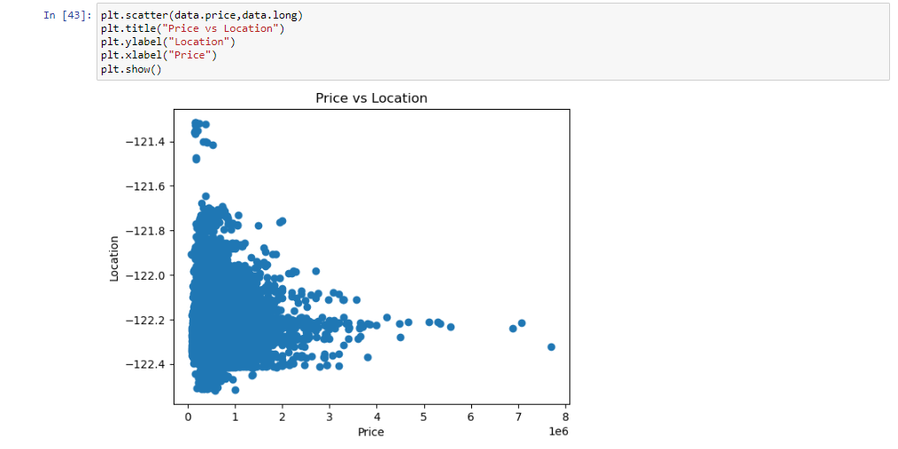
Location and price
The following graphs show the most suitable location and how much price is asked in that area. Price being represented in 100,000

Slide 8
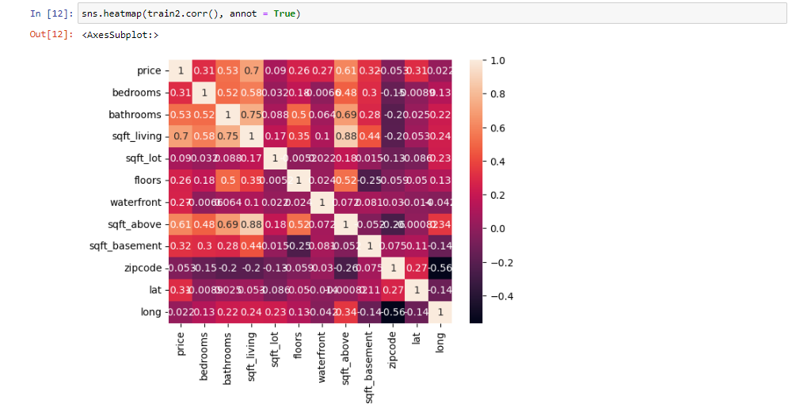
heatmap

Slide 9
Linear regression algorithm
We import our dependencies , for linear regression we use sklearn (built in python library) and import linear regression from it.
We again import another dependency to split our data into train and test.
I have made my train data as 90% and 10% of the data to be my test data, and randomized the splitting of data by using random_state.
So now, we have train data , test data and labels for both let us fit our train and test data into linear regression model.
After fitting our data to the model we can check the score of our data ie , prediction. in this case the prediction is 73%

Slide 10
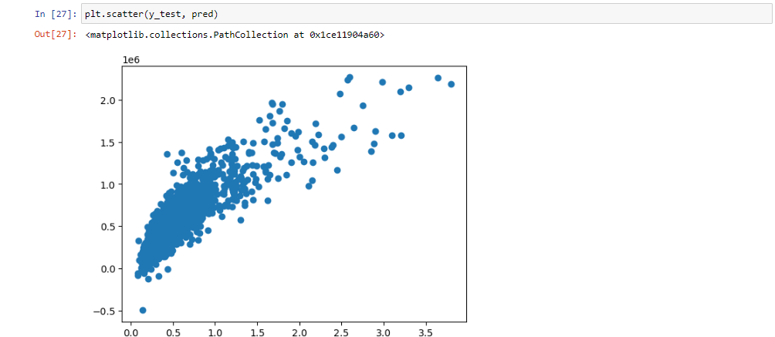
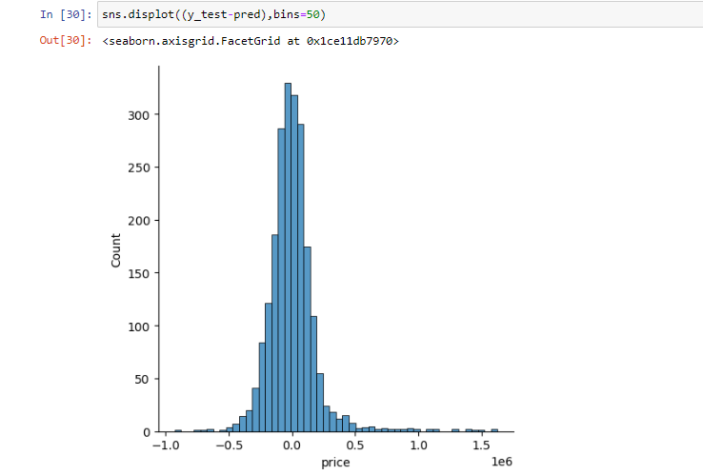
Linear regression scatter plot

Slide 11
THANK YOU!!!

